Slide 1

Movie match for android A penny for your thoughts ltd.
By: Matthew Penny

Slide 2
Agenda
Project Timeline
Application Description
Wireframes, Original & Adapted
Database
Extra Documents
Activities at a Glance
Swiping and Matching
Account Update and Delete
Third-Party Applications
External Resources

Slide 3
Project Timeline
JUNE 2022
After finishing courses, a proposal was put together, submitted to the school and accepted in time to start the implementation.
JULY 2022
The planning stages took the first few weeks, then into coding, testing and many prototype iterations. A direction change occurred mid month. Documentation started at month end.
AUGUST 2022
Documentation was finalized, current presentation built, and final bugs were worked on. Application not ready for the Play Store but large leaps in learning were earned.

Slide 4
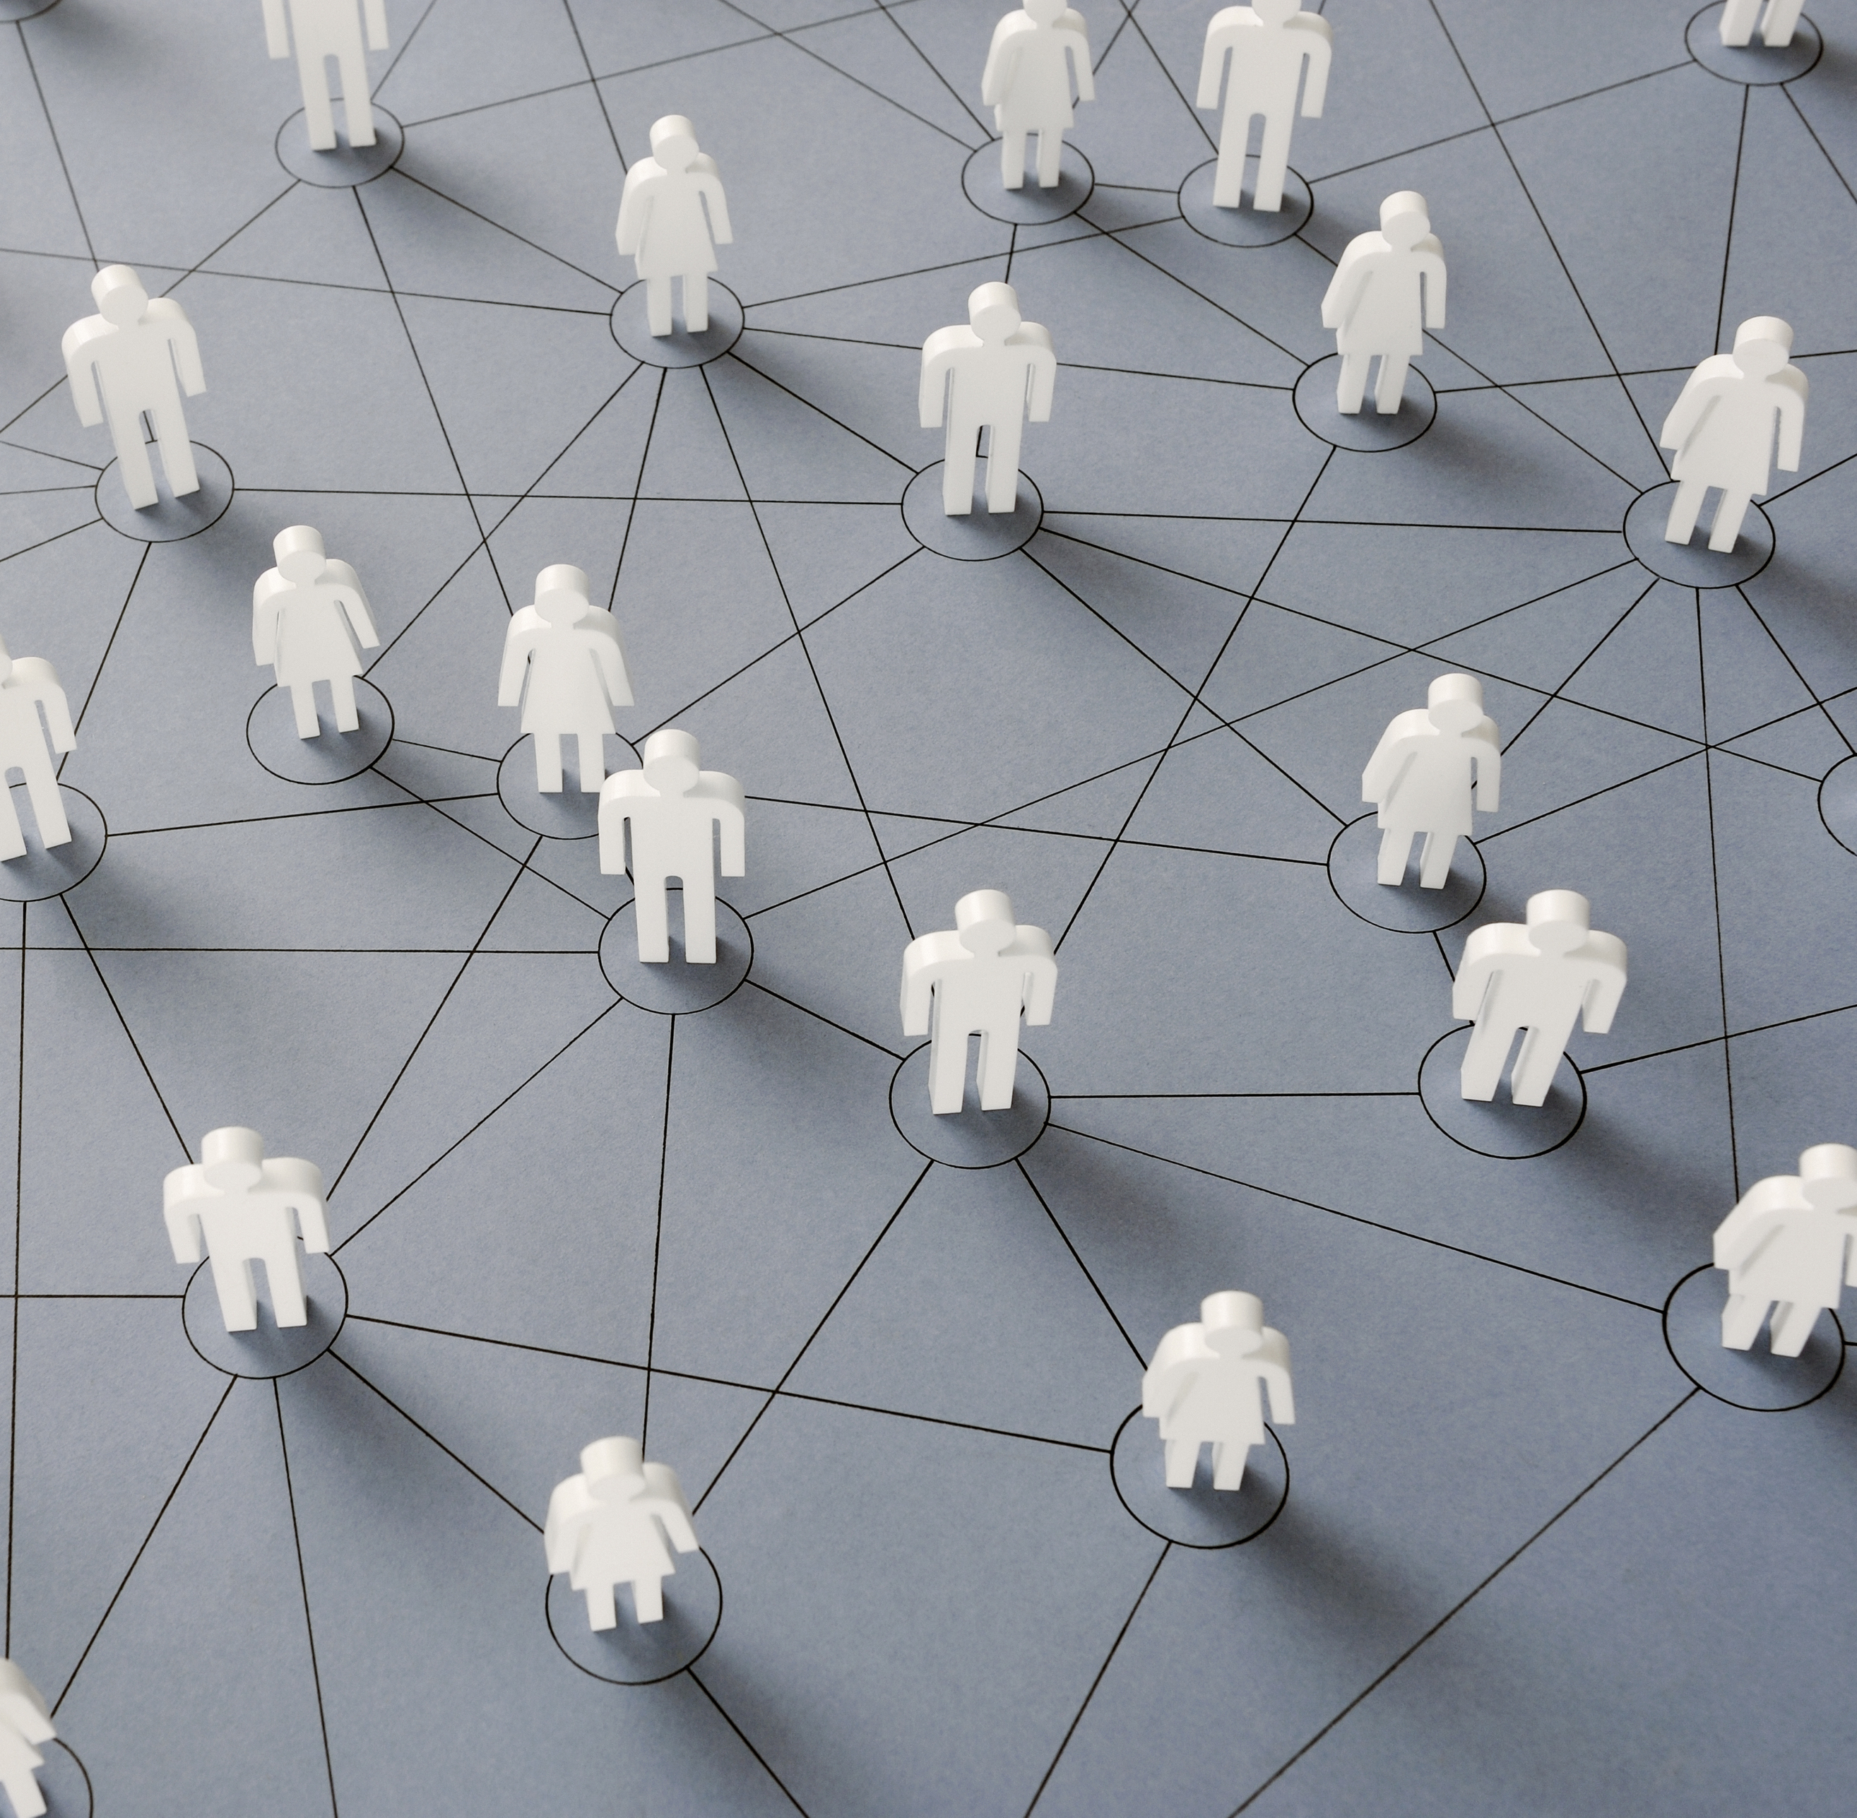
Application Description
Original Pitch
An app that can help indecisive couples find a match across multiple streaming platforms and genres through a lobby that could be accessed through an OTP and/or hyperlink.
Midterm Pitch
An app that will help connect like minded people and find someone to watch a movie or series with. They could be in the same room or across the country, allowing for people who are isolated to connect with others through similar movie and series preferences.

Slide 5
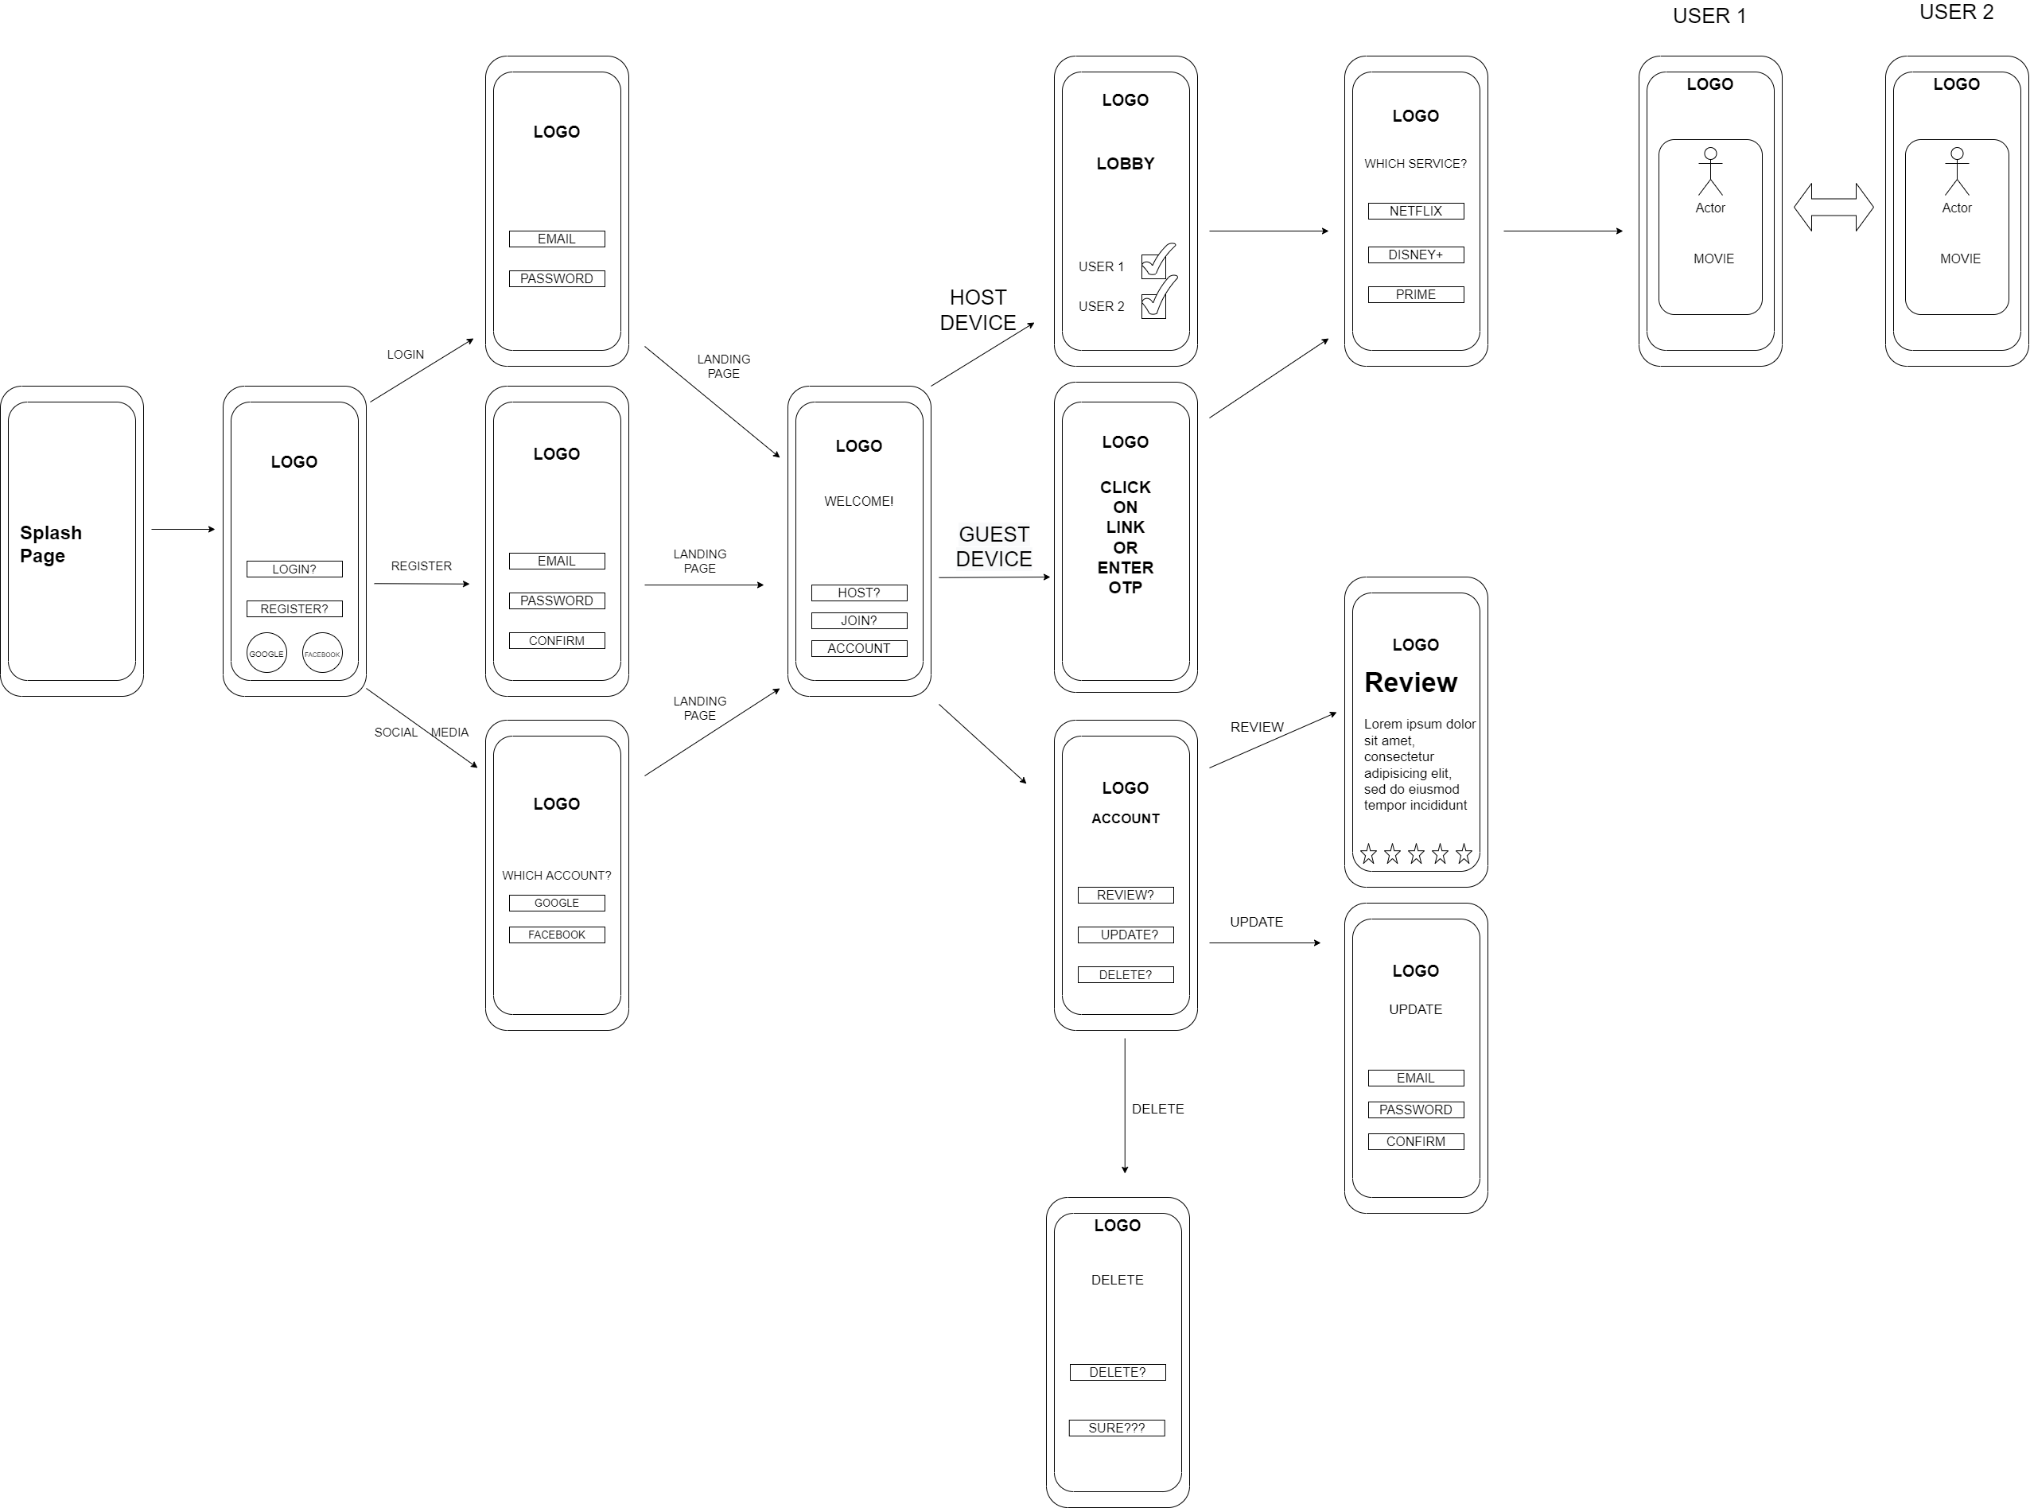
Wireframe Diagram (Original)

Slide 6
Wireframe Diagram (After Change)

Slide 7
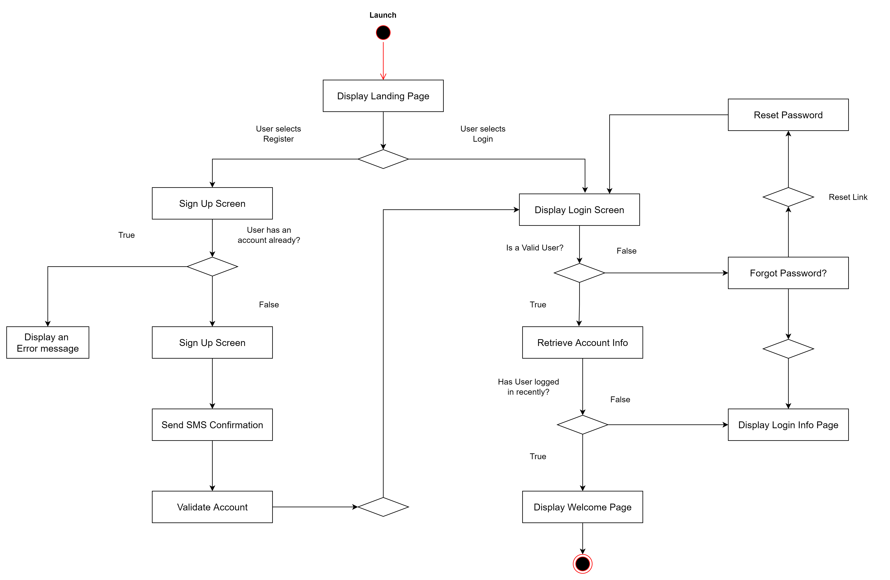
User registration and login

Slide 8
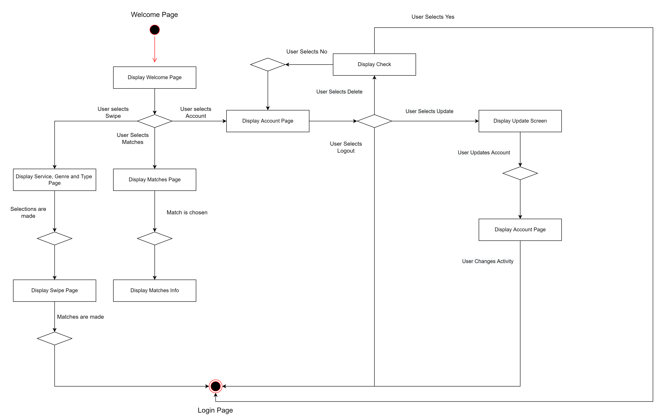
Swipes and matches

Slide 9
DATABASE & CARDINALITIES
Original Database Design
Original Database Cardinalities
Original and Final JSON Trees
Final Database Design
Final Cardinalities

Slide 10
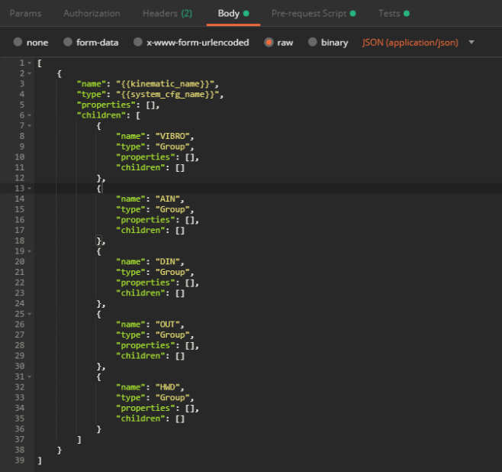
Database Design & Format
We used Firebase for our Database needs, as the fluidity allowed us to make changes on the fly as creating and displaying matches was a large roadblock during the SDLC. Firebase tables are more closely related to JSON trees than a traditional SQL table, which both helped and hindered us during the implementation of the project. Due to a change from the original idea, there are two sets of diagrams.

Slide 11
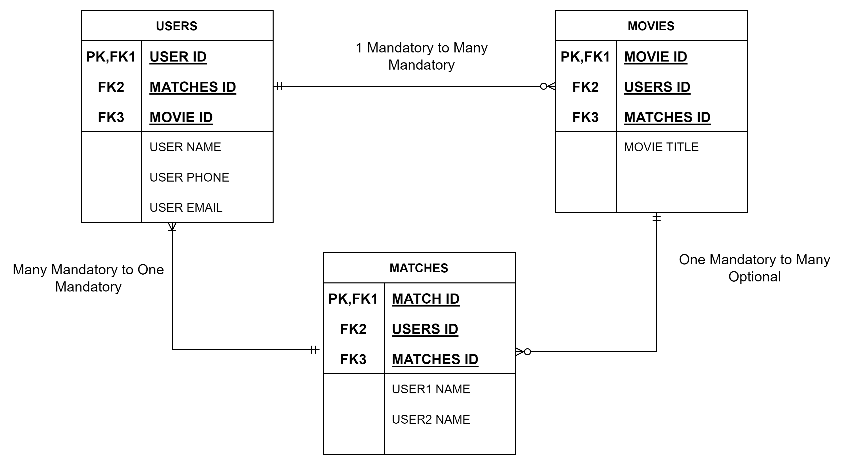
Original Database Cardinalities

Slide 12
Original Database Cardinalities
We looked at the different cardinalities for our project and produced the following set:
Users – One Mandatory to Many Mandatory in relation to Movies table, Many Mandatory to One Mandatory in relation to Matches table.
Movies – Many Optional to Many Optional in relation to Users table, One Mandatory to Many Mandatory in relation to Matches tab
Matches – One Mandatory to Many Mandatory in relation to Users table, Many Optional to One Mandatory in relation to Movies table.

Slide 13
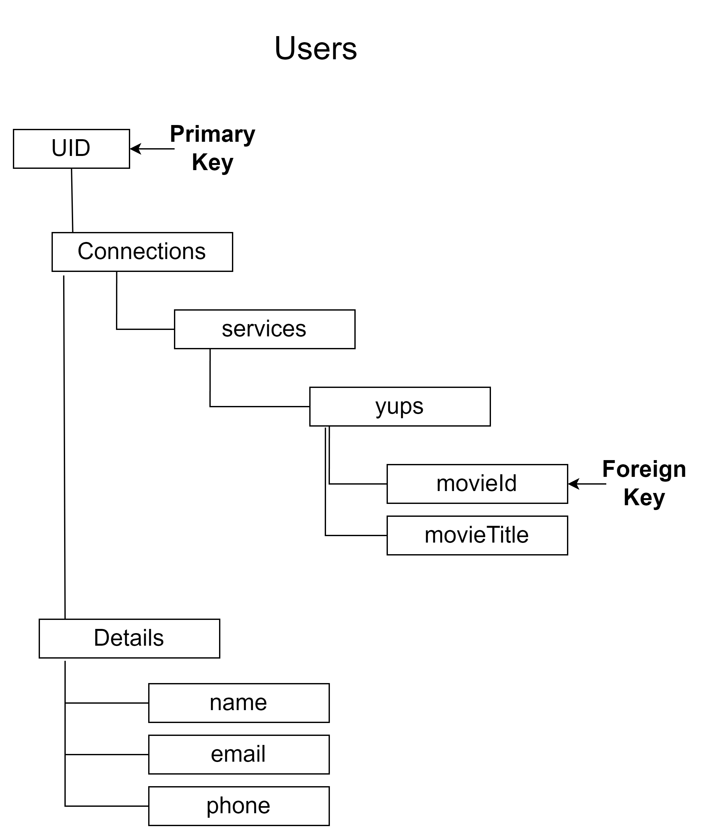
Original JSON Data Tree
UID (User ID) - Generated automatically by Firebase, makes a great PK as it has a unique value.
Connections – Holds all services, as well categorizing the movies confirmed as well as an ID for reference.
Details – Contains all user details, used for displaying in the Match’s table.

Slide 14
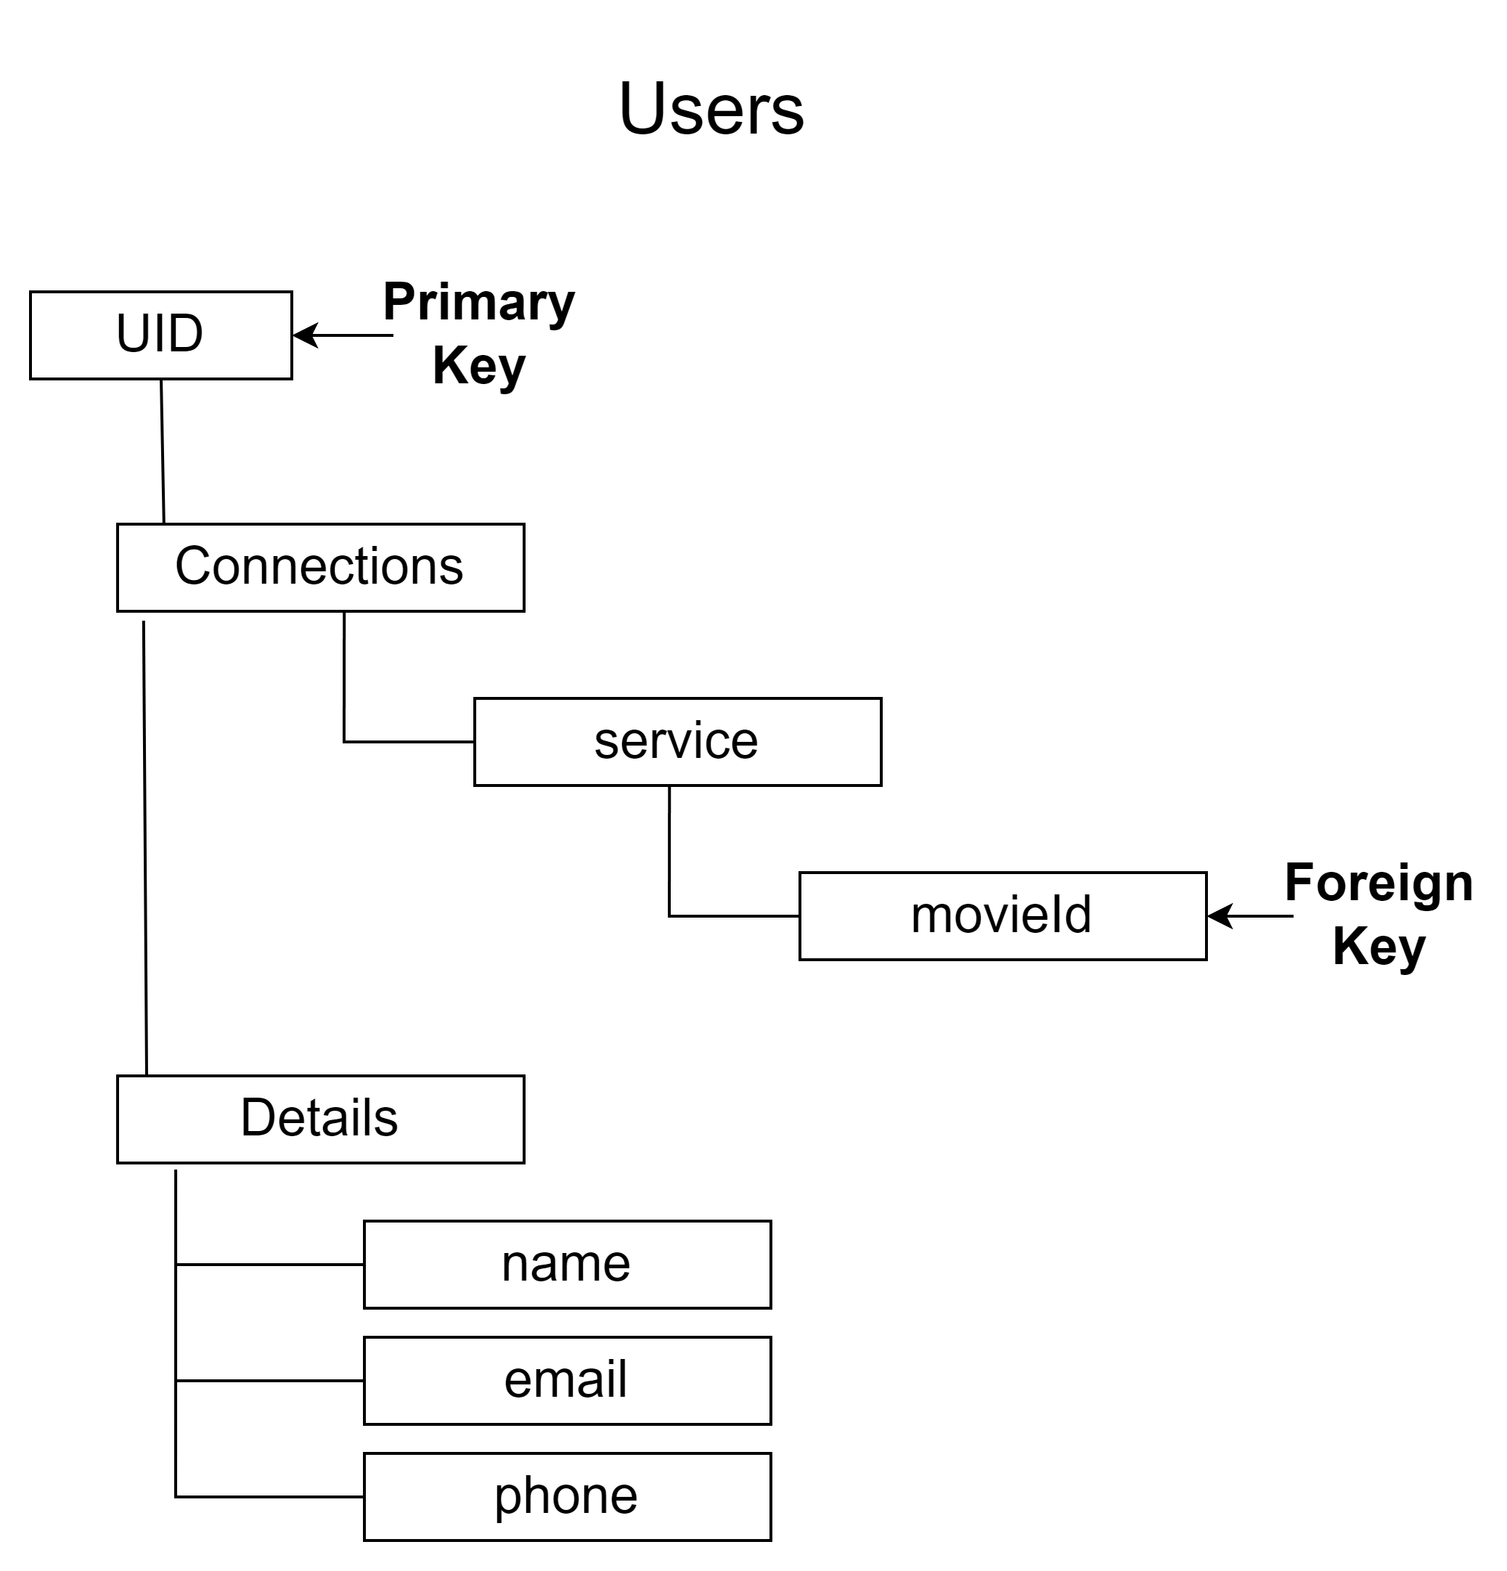
Final Tree Design
We removed the “yups” section from the JSON tree as we discovered that this was an unnecessary node and caused issues when trying to drill down for the information needed.

Slide 15
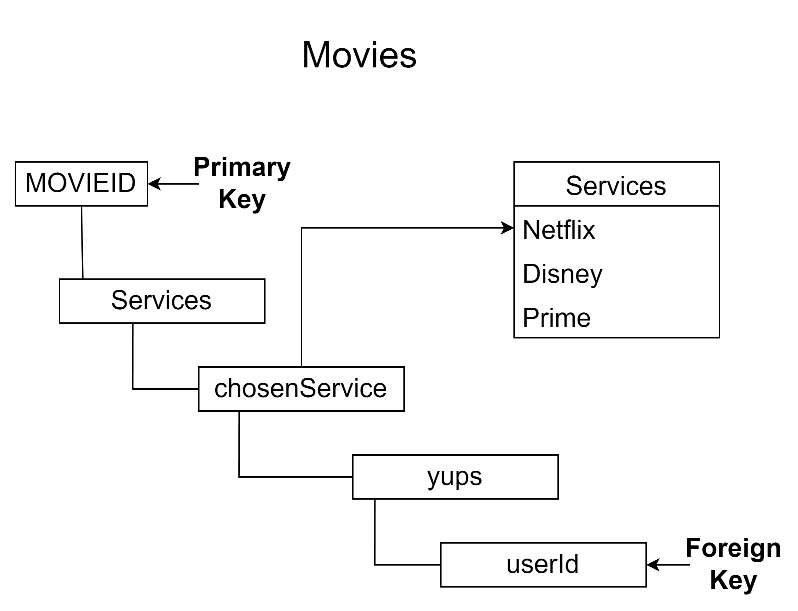
Original JSON Data Tree
MOVIEID – Generated by Firebase, which makes it a great primary key (as mentioned on Users table).
chosenServices – Holds any of the services utilized by the API, helps with sorting the movies and series
userId – Foreign key utilized for reference checks with the Users table

Slide 16
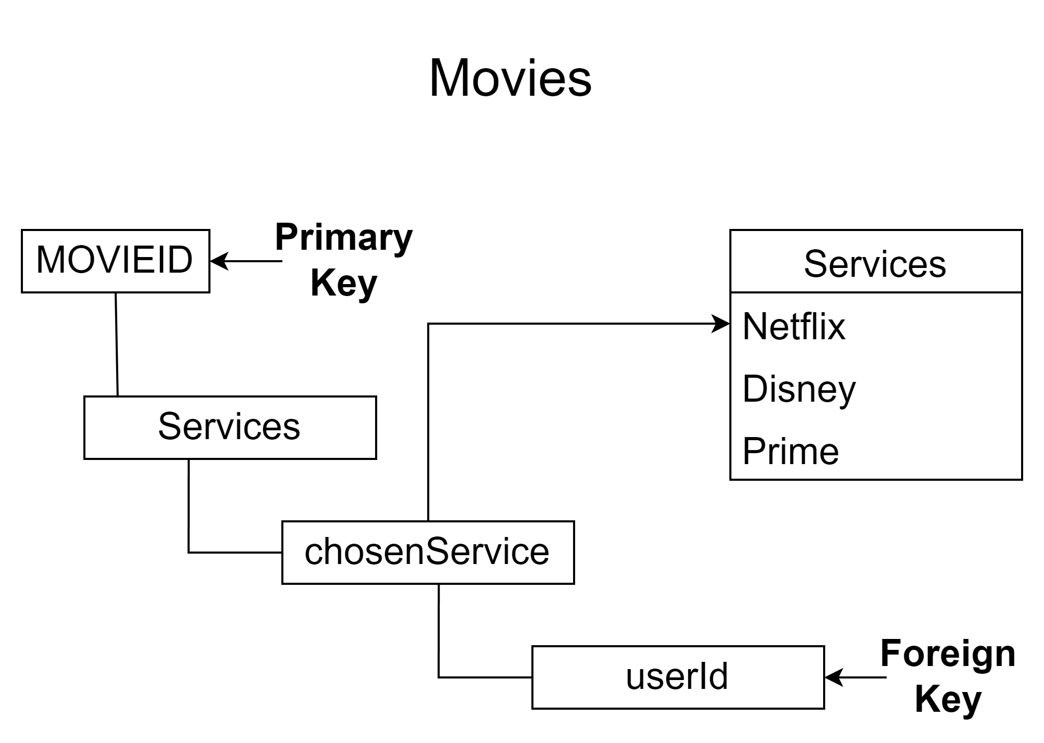
Final Tree Design
There was little to change for the Movies tree except for “yups” node, same as mentioned in the Users tree.

Slide 17
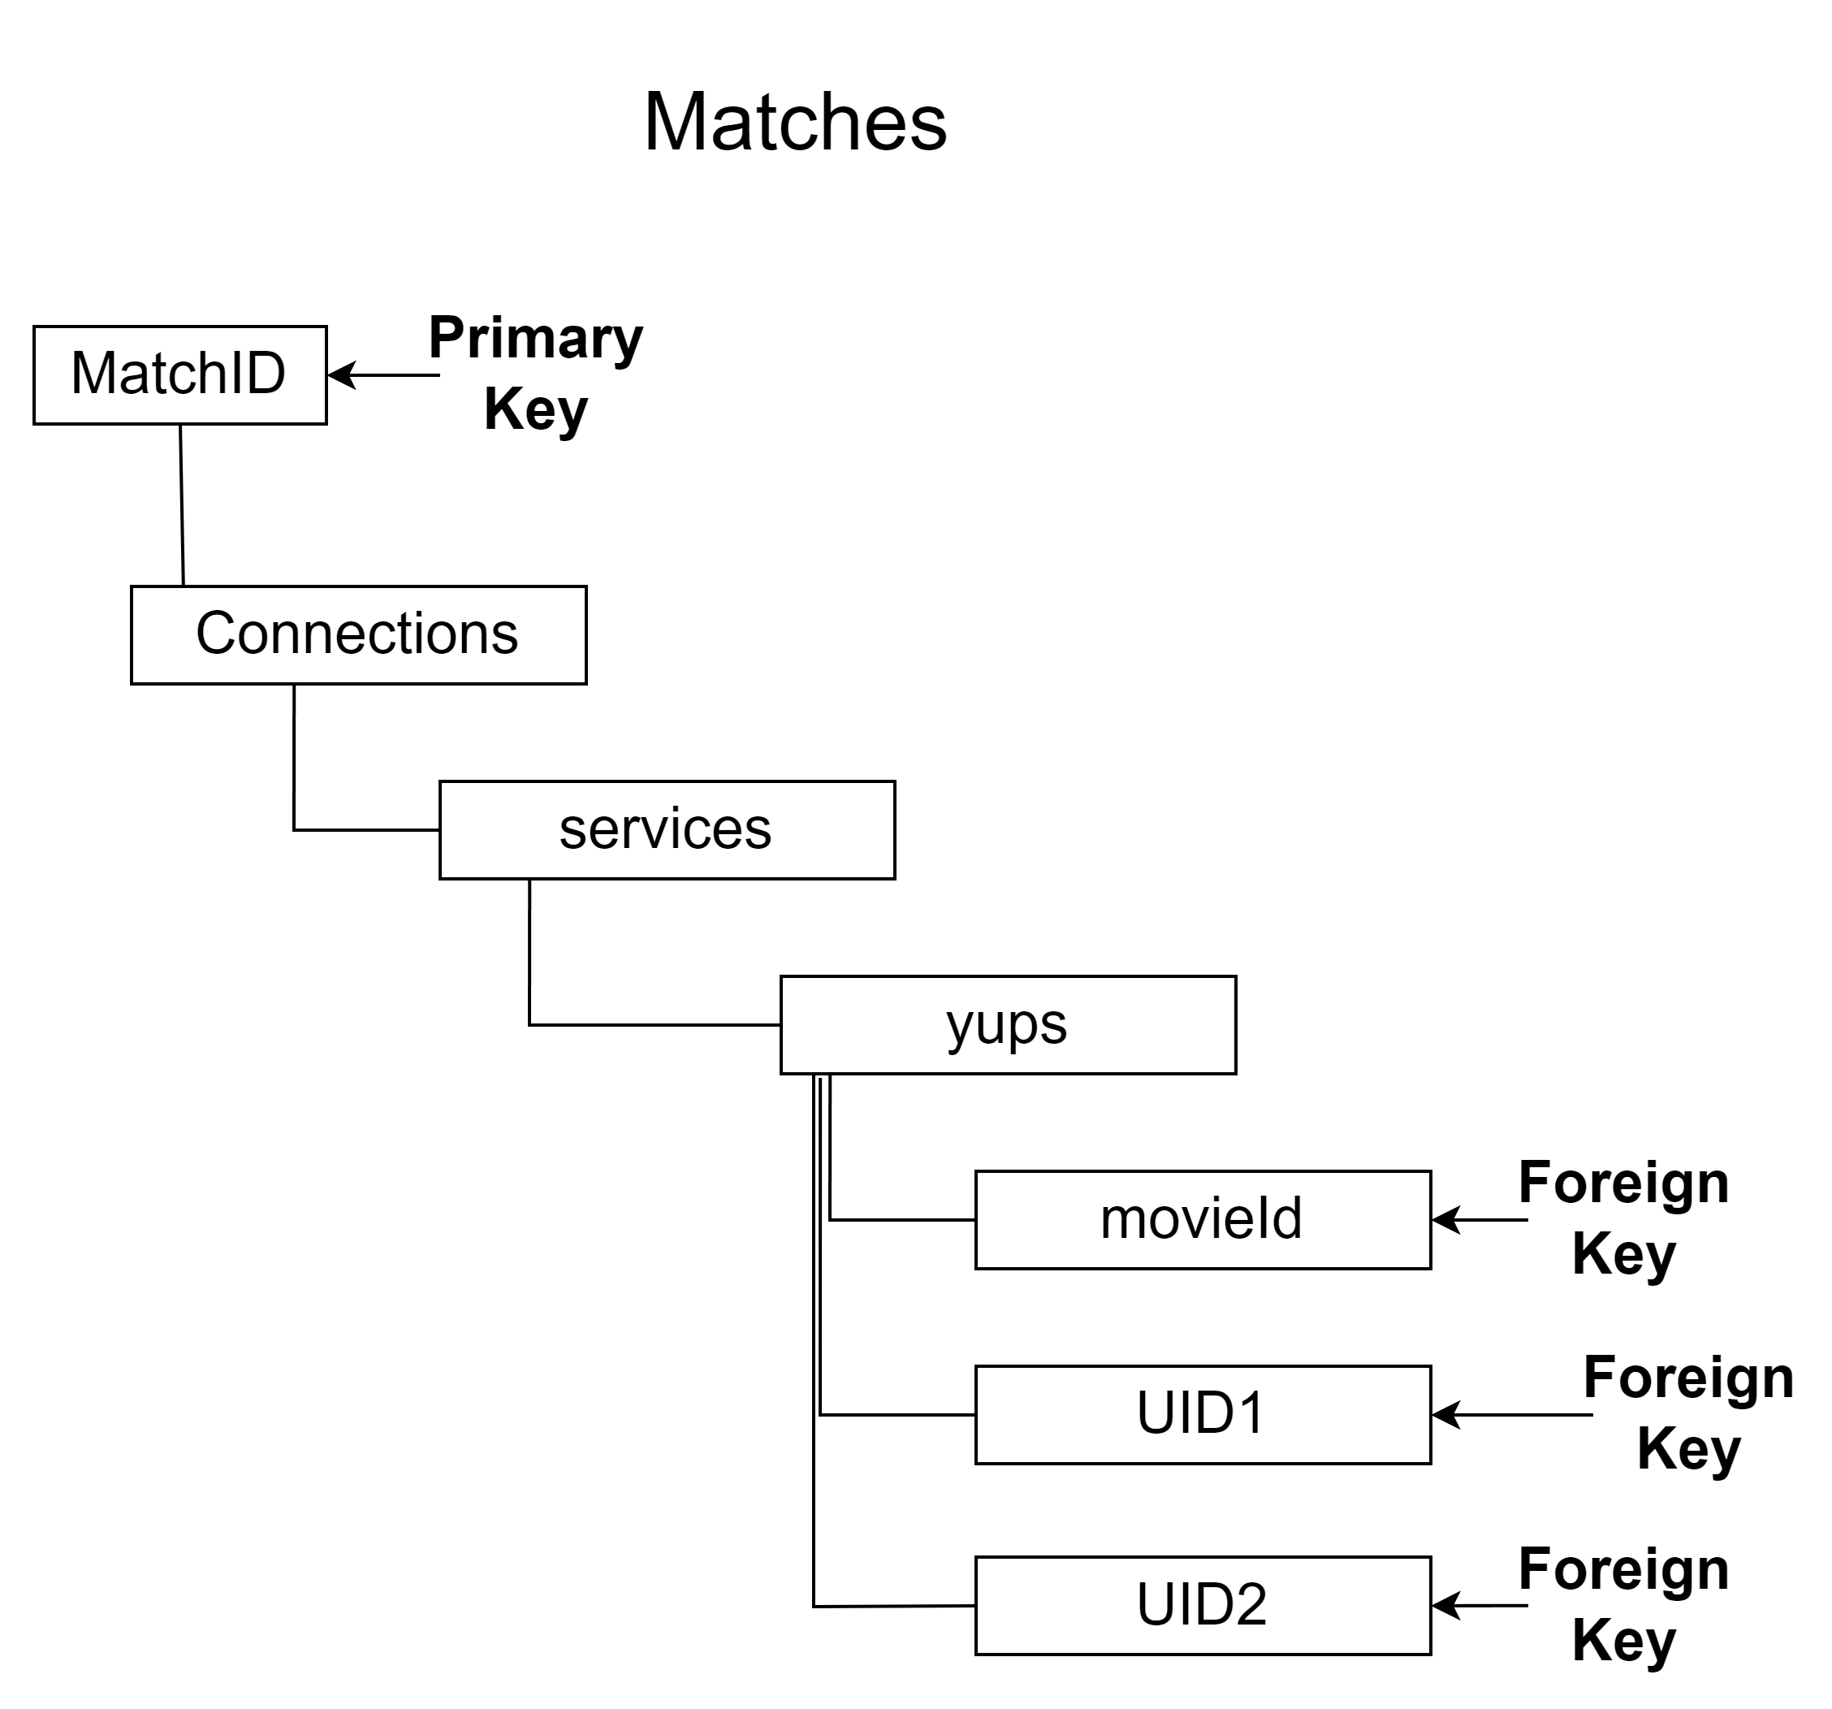
Original JSON Data Tree
MOVIEID – Generated by Firebase, which makes it a great primary key (as mentioned on Users table).
chosenServices – Holds any of the services utilized by the API, helps with sorting the movies and series
userId – Foreign key utilized for reference checks with the Users table

Slide 18
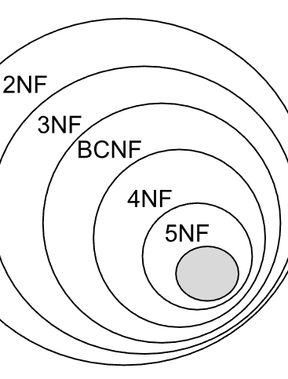
Final Tree Design
After the logic was rebuilt to allow users to match with anyone else who has swiped on the same movie, the Matches table was deemed redundant. As we know, from our Database design courses, its best to run a database through the normalization process to ensure that information isn’t repeated for no reason throughout the entities.

Slide 19
Extra documents

Slide 20
Privacy Policy
As the application (at the moment) requires a phone number to be able to contact each other’s Matches, we created a Privacy Policy form that will be able to be accessed through the application. We created this with the help from Termly, which ensured that we were able to ensure that we are covered in case of breach.
Here you can see the Privacy Policy:
Privacy Policy

Slide 21

How to Use Manual
Built into the application is the Navigation Drawer Menu. One of the options given here is the “How to Use” manual. This section is a FAQ for users to read and know how the application works without being too heavy or overly technical. Also, there has been a separate document created which gives a more in-depth User Manual for those that would like to dive deeper.

Slide 22

Software Design Document
The Software Design Document outlines the different software requirements and translates them into a representation of components, interfaces and data necessary for the implementation of the project. Here at A Penny for Your Thoughts, we endeavor to follow the IEEE Recommended Practice for Software Design Documents, simply at a slightly reduced level.
Here you can see the SDD:
Movie Match Software Design Document

Slide 23
Activities at a glance

Slide 24
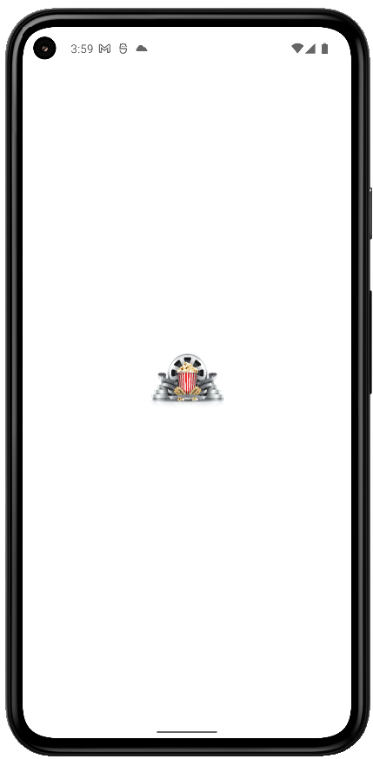
Launch Screen
While launching, we treat the users to the Movie Match logo, with which we hope to invoke some feelings of a few decades ago when theatres were the way to go for a group viewing experience.

Slide 25
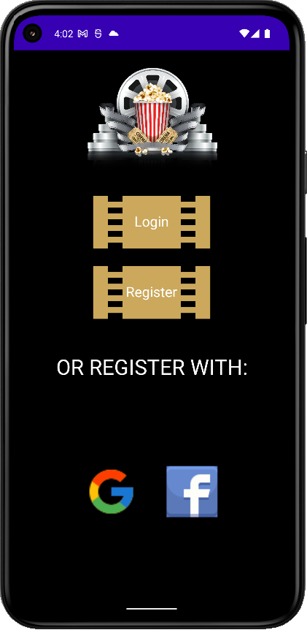
Landing Screen
Landing page shows the login options and will allow users to register using Google, Facebook or the application’s own Firebase authorization by using email and password.

Slide 26
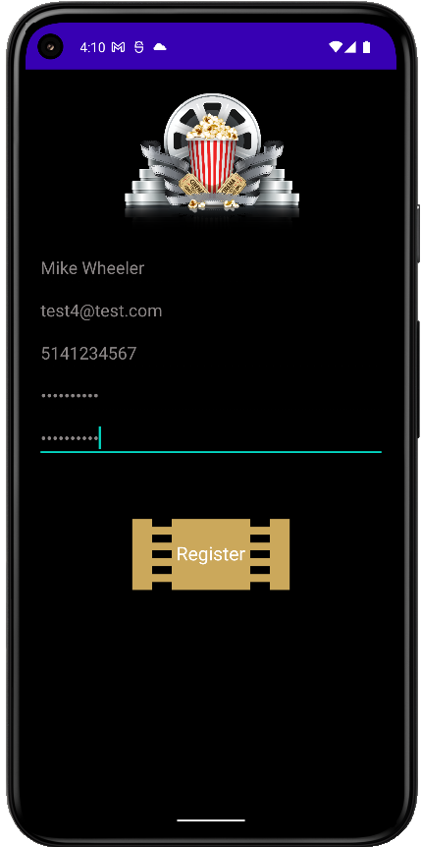
Register Screen
Our register activity allows users to keep their information separate from third party sources and can be assured that their information will be kept secure with Firebase’s security measures.

Slide 27
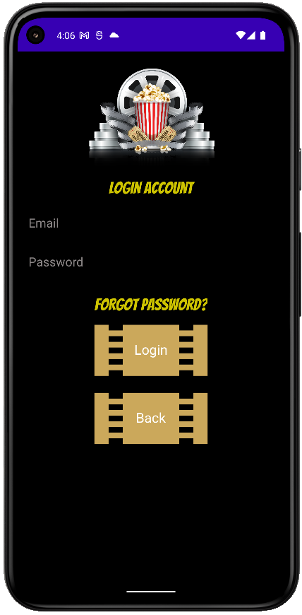
Login Screen
(With Account)In case of a long pause from the application, a change of password or from an accidental logout, this activity will use the credentials from Firebase to login. As well, the “Forgot Password?” link is active here for a quick reset.

Slide 28
Swiping and matching

Slide 29
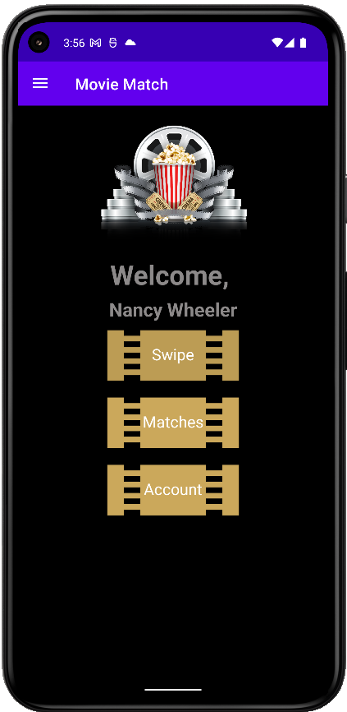
Welcome Screen
From here, we can start move through the main stages of the application in all it’s glory!
Swipe does this…
Matches does that…
Account does the other thing…

Slide 30
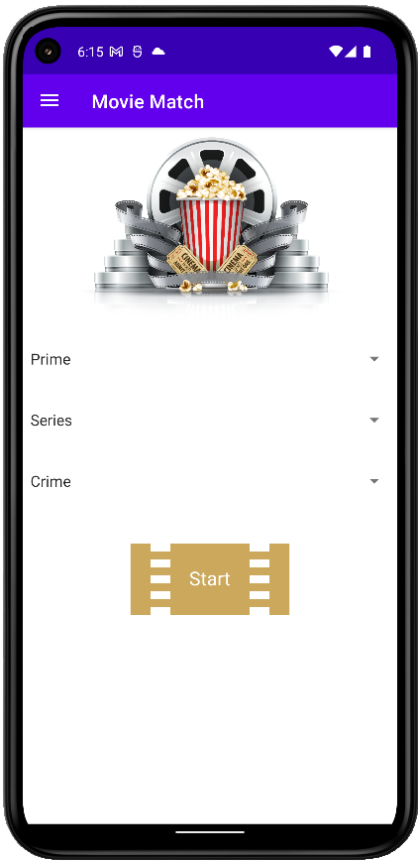
Service, Genre & Type Screen
Choose from:
Services include Prime, Netflix and Disney+
Type includes Movies and Series
Genre holds everything from Action to Sci Fi to Musicals

Slide 31
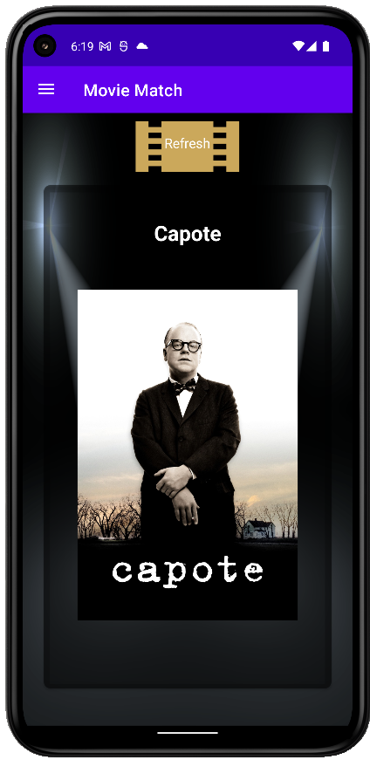
Swipe Screen
The Swipe Activity shows every movie and series available to the API, dependent upon the Service, Genre and Type in groups of 8, as per the API call.
On a single click, we can see details of the film, including runtime, language and year released.
On a long click, we can change the Service so we can see the different movies under the same Genre without changing screens.
If you choose incorrectly, you can push UNDO in the Snackbar prompt.

Slide 32
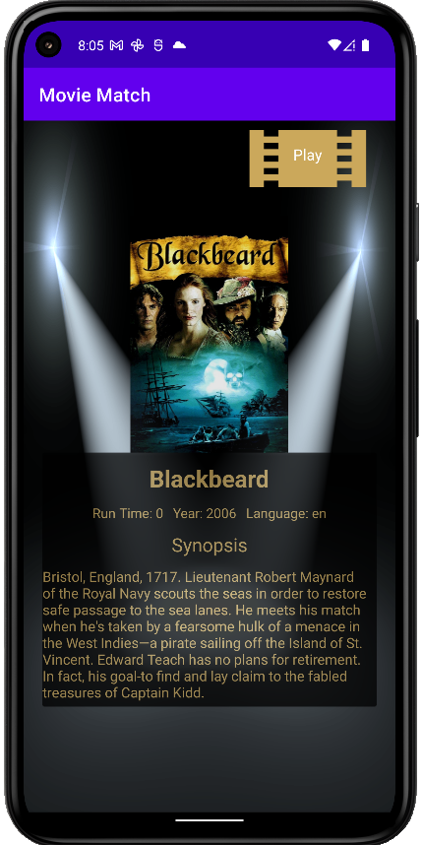
Details Screen
The single click on any movie or series brings you to the Details screen, outlining runtime, year released, original language and a small synopsis on the chosen film or series.
The Play button here will allow users who are not looking for a match to start watching any film or series that they so choose.

Slide 33
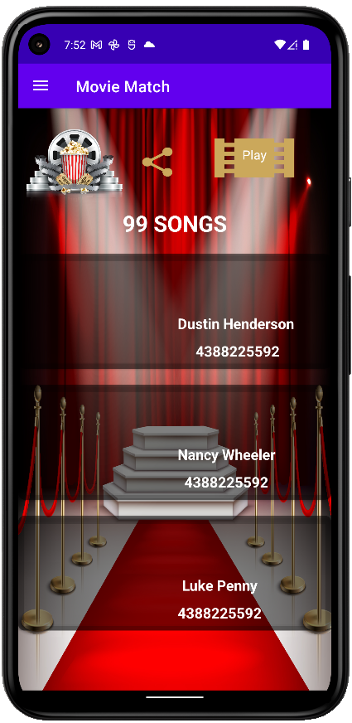
Matches Screen
Once a movie or series that you like has other users, we are taken to the Matches Activity where we can see the details of other users.
With a single click, we are taken to the device’s default messaging application. There will be a pre-determined message already written, informing the other user that you have matched on the same movie.
The Share icon allows users to share to their application of choice. This can be social media, message to another unmatched user or email.
The Play button can be used here if a user wants to start watching immediately, opening either the platform’s application or the web version.

Slide 34
Account page and update

Slide 35
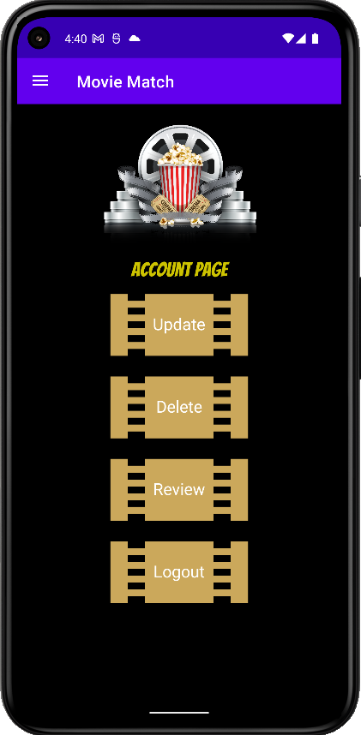

Account Screen
This activity allows the user to:
Update their information as well as add a profile image that will be shown in the Matches page
Delete their account and information from our database
Logout their account from the current device
Review button would be programmed to allow users to directly review the app on the Play Store (wishful thinking )

Slide 36
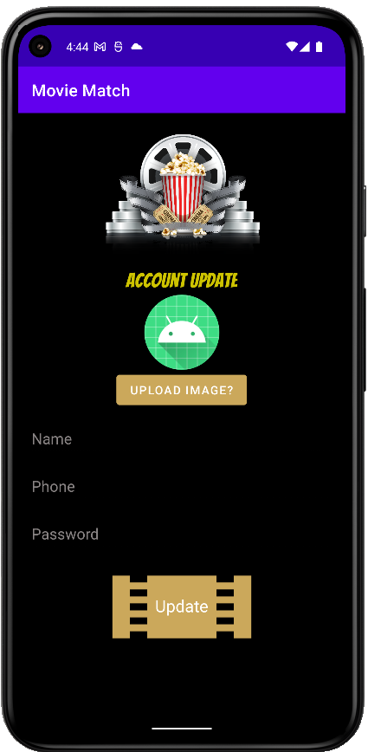
Update Screen
The user can update their account information to ensure they appear to their matches as they wish. As well, they can upload an image from their device for other users to see. We have not completed the user image section of the Matches Recycler View, but this will be implemented soon.

Slide 37
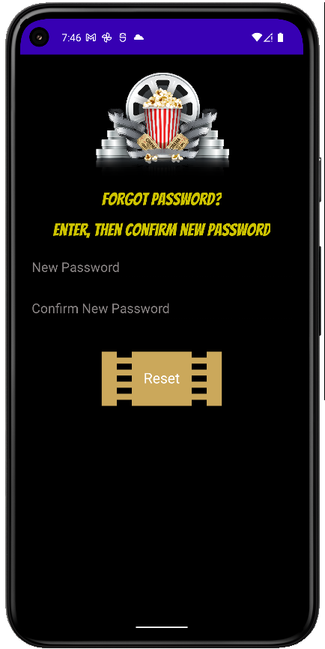
Forgot Password Screen
A User can change a forgotten password without having to leave the application. Once reset, the User is redirected back to the Login page to pass through authentication once more.

Slide 38
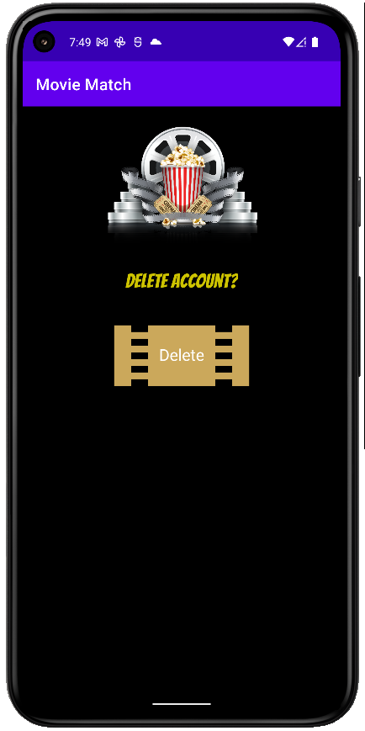
Delete Screen
If Users feel like Movie Match is not for them, deleting their account is as easy as pushing the delete button found just past the Account page. A Penny for Your Thoughts does not keep user records or personal information after the delete option is chosen.

Slide 39
Third-party applications

Slide 40
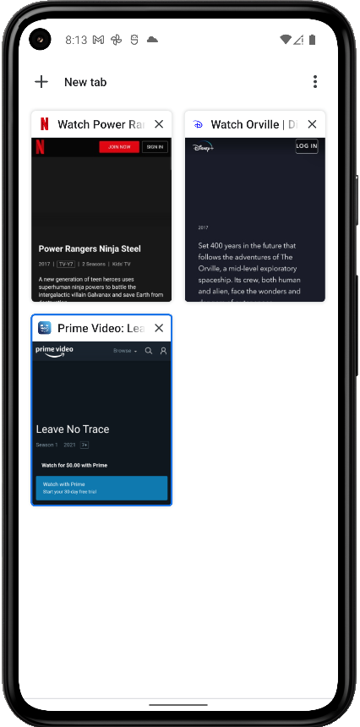
Streaming Platforms
The Play button from both Details and Matches work in one of two ways:
If the platform is already installed and the user is logged in, the Play button will open directly to the movie or series on the specified platform.
If not, then the user is redirected to the website version of the specified platform.

Slide 41
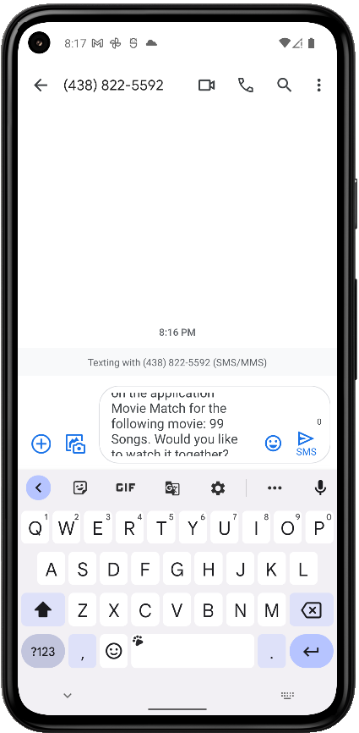
Messaging
Once a User has liked movies or series that others have as well, a single click on their details will take you to your messaging application. There will be a pre-rendered message there that the User can change if they wish.

Slide 42
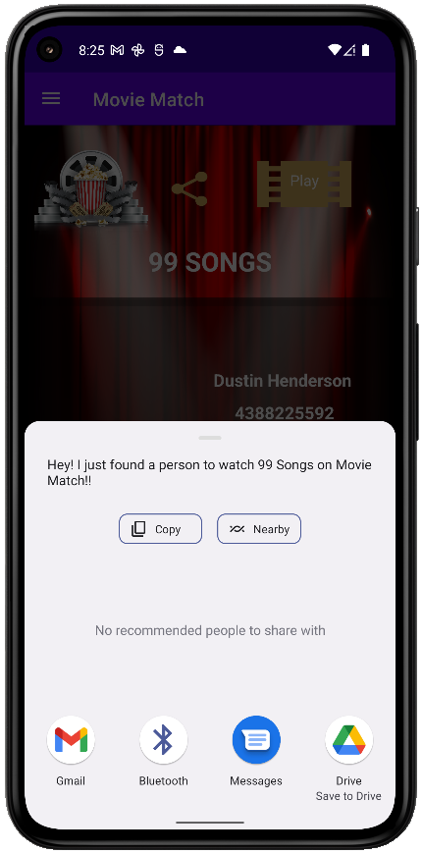
Social Media Sharing
Also, from the Matches page, a User can share the movie or series on the social media platform of their choice. This way, Users can share the fun of finding and matching with their ever-growing circle of like-minded movie lovers!

Slide 43
External resources

Slide 44
Resources
SimCoder YouTube Playlist – Make an Android App like Tinder Parts 1 through 14 - YouTube Watch Link
Android Developer Documentation – here
Google Developer Documentation – here
TidyForms.com – Template for SDD (#2)
Termly – privacy policy generator
GeeksforGeeks
Stackoverflow

Slide 45

Questions, Comments, Thoughts?

